Slide 1
K-Means

Slide 2
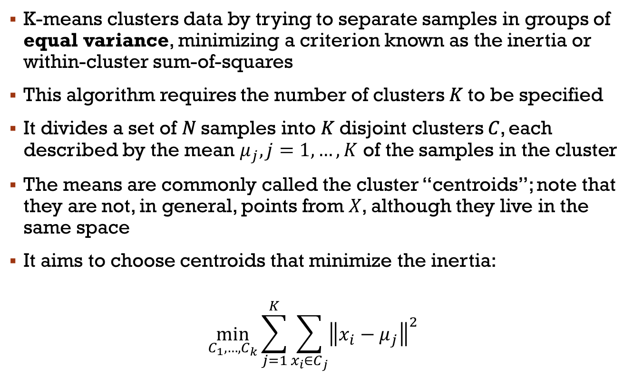
K-means
K-means clusters data by trying to separate samples in groups of equal variance, minimizing a criterion known as the inertia or within-cluster sum-of-squares
This algorithm requires the number of clusters 𝐾 to be specified
It divides a set of 𝑁 samples into 𝐾 disjoint clusters 𝐶, each described by the mean $μ_{j}, j=1,…,K$ of the samples in the cluster
The means are commonly called the cluster “centroids”; note that they are not, in general, points from 𝑋, although they live in the same space
It aims to choose centroids that minimize the inertia:
$$\min_{C_{1},…,C_{k}}{\sum_{j=1}^{K}{\sum_{x_{i}∈C_{j}}{{\left\|x_{i}−μ_{j}\right\|}^{2}}}}$$

Slide 3
K-means: Drawbacks
Inertia makes assumption that clusters are convex and isotropic
It responds poorly to elongated clusters, or manifolds with irregular shapes
Inertia is not a normalized metric: we just know that lower values are better and zero is optimal
In very high-dimensional spaces, Euclidean distances tend to become inflated (this is an instance of the so-called “curse of dimensionality”)
Running a dimensionality reduction algorithm such as Principal Component Analysis (PCA) prior to k-means clustering can alleviate this problem and speed up the computations

Slide 4
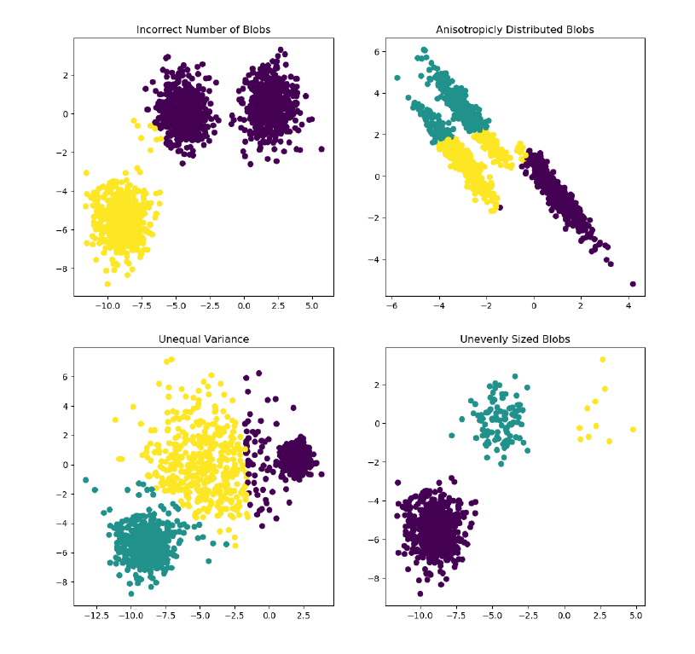
K-means: Drawbacks

Slide 5
K-means
K-means is often referred to as Lloyd’s algorithm. In basic terms, the algorithm has three steps
The first step chooses the initial centroids, with the most basic method being to choose 𝑘 samples from the dataset 𝑋
After initialization, K-means consists of looping between the two other steps. The first step assigns each sample to its nearest centroid. The second step creates new centroids by taking the mean value of all of the samples assigned to each previous centroid.
The difference between the old and the new centroids are computed and the algorithm repeats these last two steps until this value is less than a threshold. In other words, it repeats until the centroids do not move significantly

Slide 6
K-means
K-means is equivalent to the expectation-maximization algorithm with a small, all-equal, diagonal covariance matrix
The algorithm can also be understood through the concept of Voronoi diagrams
First the Voronoi diagram of the points is calculated using the current centroids. Each segment in the Voronoi diagram becomes a separate cluster.
Secondly, the centroids are updated to the mean of each segment. The algorithm then repeats this until a stopping criterion is fulfilled
Usually, the algorithm stops when the relative decrease in the objective function between iterations is less than the given tolerance value
This is not the case in this implementation: iteration stops when centroids move less than the tolerance

Slide 7
K-means
Given enough time, K-means will always converge, however this may be to a local minimum. This is highly dependent on the initialization of the centroids. The computation is often done several times, with different initializations of the centroids
One method to help address this issue is the k-means++ initialization scheme, which has been implemented in scikit-learn (use the init='k-means++' parameter). This initializes the centroids to be (generally) distant from each other, leading to provably better results than random initialization
The algorithm supports sample weights, which can be given by a parameter sample_weight. This allows to assign more weight to some samples when computing cluster centers and values of inertia. For example, assigning a weight of 2 to a sample is equivalent to adding a duplicate of that sample to the dataset 𝑋

Slide 8
Initialization
Commonly used initialization methods are Forgy and Random Partition
Forgy method randomly chooses k observations from the dataset
Random Partition method first randomly assigns a cluster to each observation and then proceeds to the update step
Forgy method tends to spread the initial means out, while Random Partition places all of them close to the center of the data set
Random Partition method is generally preferable for algorithms such as the k-harmonic means and fuzzy k-means. For expectation maximization and standard k-means algorithms, the Forgy method of initialization is preferable
In general, popular initialization methods such as Forgy, Random Partition, and Maximin often perform poorly, whereas Bradley and Fayyad's approach performs "consistently" in "the best group" and k-means++ performs "generally well"

Slide 9
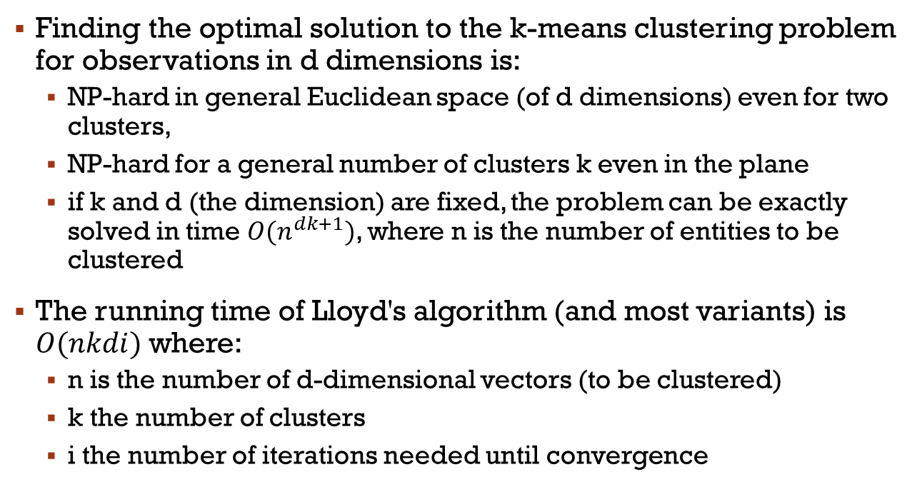
Complexity
Finding the optimal solution to the k-means clustering problem for observations in d dimensions is:
NP-hard in general Euclidean space (of d dimensions) even for two clusters,
NP-hard for a general number of clusters k even in the plane
if k and d (the dimension) are fixed, the problem can be exactly solved in time $O(n^{dk+1})$, where n is the number of entities to be clustered
The running time of Lloyd's algorithm (and most variants) is $O(nkdi)$ where:
n is the number of d-dimensional vectors (to be clustered)
k the number of clusters
i the number of iterations needed until convergence

Slide 10
Complexity
On data that does have a clustering structure, the number of iterations until convergence is often small, and results only improve slightly after the first dozen iterations
Lloyd's algorithm is therefore often considered to be of "linear" complexity in practice, although it is in the worst-case super-polynomial (exponential) when performed until convergence
Lloyd's algorithm is the standard approach for this problem. However, it spends a lot of processing time computing the distances between each of the k cluster centers and the n data points
Since points usually stay in the same clusters after a few iterations, much of this work is unnecessary, making the naive implementation very inefficient
Some implementations use caching and the triangle inequality in order to create bounds and accelerate Lloyd's algorithm

Slide 11
Mini Batch KMeans

Slide 12
Mini-Batch-KMeans
Mini-Batch-KMeans is a variant of the KMeans algorithm which uses mini-batches to reduce the computation time, while still attempting to optimize the same objective function
Mini-batches are subsets of the input data, randomly sampled in each training iteration. These mini-batches drastically reduce the amount of computation required to converge to a local solution
In contrast to other algorithms that reduce the convergence time of k-means, mini-batch k-means produces results that are generally only slightly worse than the standard algorithm

Slide 13
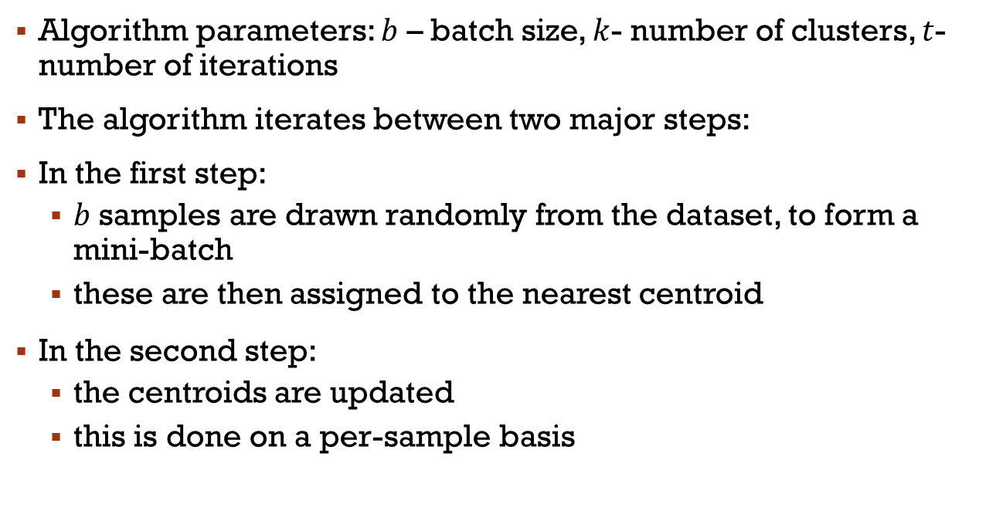
The Algorithm
Algorithm parameters: $b$ – batch size, $k$- number of clusters, $t$-number of iterations
The algorithm iterates between two major steps:
In the first step:
$b$ samples are drawn randomly from the dataset, to form a mini-batch
these are then assigned to the nearest centroid
In the second step:
the centroids are updated
this is done on a per-sample basis

Slide 14
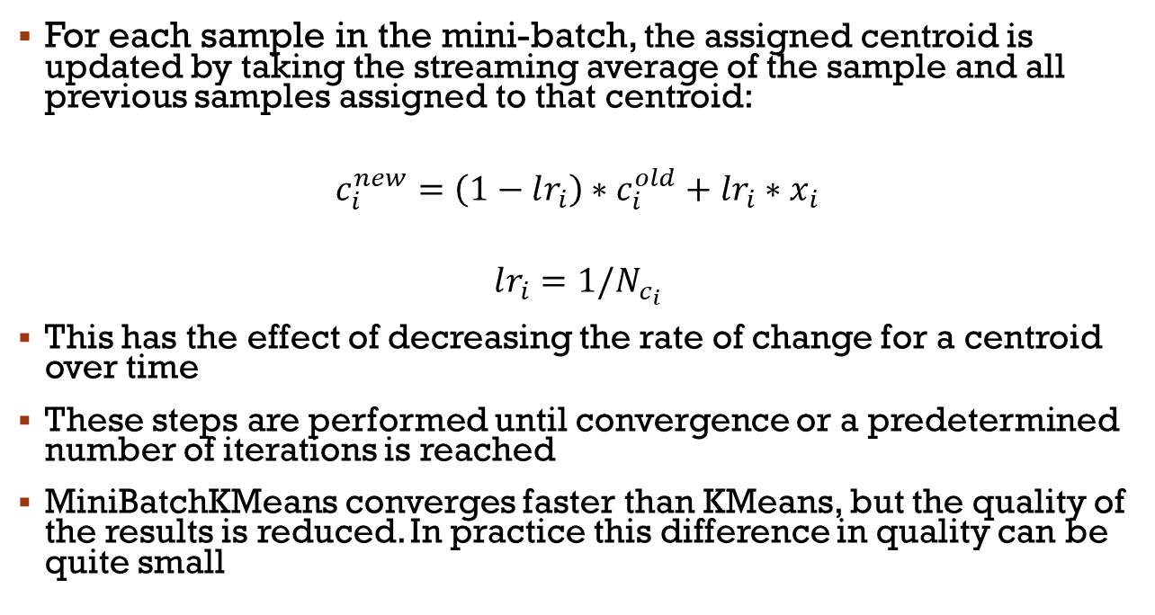
The Algorithm
For each sample in the mini-batch, the assigned centroid is updated by taking the streaming average of the sample and all previous samples assigned to that centroid:
$$c_{i}^{new}=\left(1−lr_{i}\right)∗c_{i}^{old}+lr_{i}∗x_{i}$$
$$lr_{i}=1/N_{c_{i}}$$
This has the effect of decreasing the rate of change for a centroid over time
These steps are performed until convergence or a predetermined number of iterations is reached
MiniBatchKMeans converges faster than KMeans, but the quality of the results is reduced. In practice this difference in quality can be quite small

Slide 15
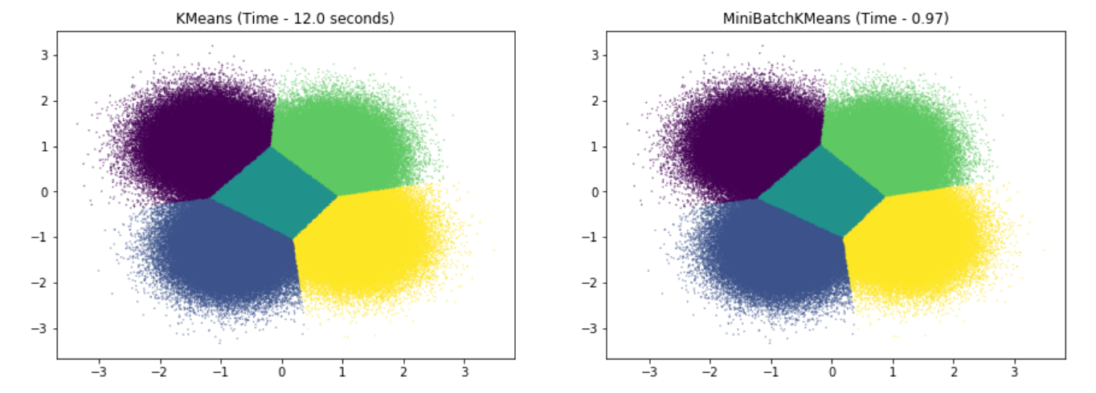

Slide 16
